Slide 1
691 Capstone — Challenge 1 Summary
Data ingest → Normalized schema → Postgres loads → EDA → MA4 forecast
Patrick Horgan

Slide 2
Project Pipeline
Ingested CSVs: Products, Promotions, Inventory, Sales (Q1–Q4)
Designed ERD → Created normalized Postgres schema (PKs, FKs, indexes)
Loaded data with staging tables & validations (row counts, orphans, ranges)
EDA in SQL: trends, top products, store KPIs, department mix, promo impact
Simple baseline forecast: 4-week moving average (MA4) per product

Slide 3
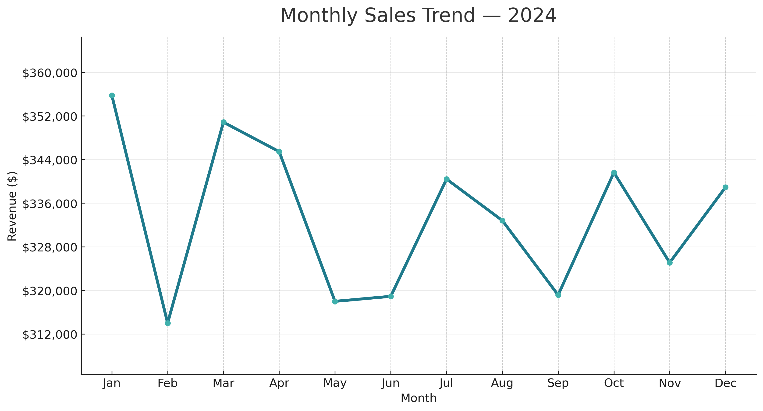

Slide 4
Technical Recap – Monthly Trends
Process:
Parsed denormalized Excel sheets (Sales, Products, Stores, Promos, etc.) into staging tables.
Normalized into 3NF schema (Fact: sales_txn; Dims: date, store, product, category, vendor).
Validated referential integrity (row counts, PK/FK constraints, orphan detection).
Ran aggregate SQL query: SELECT month, SUM(line_amount) AS revenue FROM sales_txn GROUP BY month ORDER BY month;
Meaning: This shows that the ETL + schema are functional — we can now roll up to any time grain (month, week, day) consistently.

Slide 5
Top Products by Revenue — 2024
Product_upc | Product_name | Brand | Department | Category | Units sold | Revenue | Avg unit price
6.53756E+11 | Sunrise Labs Electrolyte Powder | Sunrise Labs | Wellness | Electrolyte Powder | 16397.76 | 401907.52 | 24.51
2.16073E+11 | Sun Valley Basmati Rice | Sun Valley | Grocery | Basmati Rice | 23644.2 | 327002.8 | 13.83
5.86923E+11 | Sun Valley Rolled Oats | Sun Valley | Grocery | Rolled Oats | 23097.9 | 321062 | 13.9
7.60367E+11 | VitaCrest Vitamin D3 | VitaCrest | Wellness | Vitamin D3 | 13959.3 | 297195.45 | 21.29
8.89373E+11 | VitaCrest Multivitamin | VitaCrest | Wellness | Multivitamin | 14752.18 | 290321.62 | 19.68
3.69958E+11 | Frontier Foods Peanut Butter | Frontier Foods | Grocery | Peanut Butter | 20891.52 | 228558.72 | 10.94
2.49947E+11 | Meadow Meats Chicken Breast | Meadow Meats | Meat/Seafood | Chicken Breast | 12898.26 | 219401.7 | 17.01
7.27743E+11 | Sun Valley Quinoa | Sun Valley | Grocery | Quinoa | 19183.5 | 189152.25 | 9.86
2.56747E+11 | Ocean Crest Shrimp 16-20 | Ocean Crest | Meat/Seafood | Shrimp 16-20 | 11922.48 | 185393.52 | 15.55
2.78743E+11 | Ocean Crest Pork Chops | Ocean Crest | Meat/Seafood | Pork Chops | 11477.7 | 151847.9 | 13.23
5.41459E+11 | Sun Valley Black Beans | Sun Valley | Grocery | Black Beans | 15733.9 | 143490.62 | 9.12
9.06594E+11 | Ocean Crest Ground Beef | Ocean Crest | Meat/Seafood | Ground Beef | 8724.04 | 112538.14 | 12.9
1.90229E+11 | Greenway Kitchen Tomato Soup | Greenway Kitchen | Deli | Tomato Soup | 9034.7 | 96130.29 | 10.64
7.29807E+11 | WellNorth Probiotic | WellNorth | Wellness | Probiotic | 8071.92 | 90567.12 | 11.22
4.52991E+11 | Sunrise Labs Magnesium | Sunrise Labs | Wellness | Magnesium | 7700.4 | 82700.25 | 10.74
3.10033E+11 | WellNorth Fish Oil | WellNorth | Wellness | Fish Oil | 7844.2 | 82441.45 | 10.51
8.50672E+11 | Sack & Barrel Walnuts | Sack & Barrel | Bulk | Walnuts | 6424.68 | 62382 | 9.71
6.48237E+11 | Sun Valley Tomato Sauce | Sun Valley | Grocery | Tomato Sauce | 10646.64 | 57061.92 | 5.36
8.31368E+11 | Everton Bulk Trail Mix | Everton Bulk | Bulk | Trail Mix | 5856.6 | 50952.42 | 8.7
5.07527E+11 | Everton Bulk Brown Rice | Everton Bulk | Bulk | Brown Rice | 5767.52 | 50348.28 | 8.73

Slide 6
Technical Recap – Top Products by Revenue
Process:
Joined sales_txn (fact) with product (dim) and aggregated revenue by product ID.
Ranked with ROW_NUMBER() or RANK() to create Pareto-style ranking.
Validated totals matched store-level and month-level aggregates (sanity check).
Meaning: Confirms entity resolution (product IDs clean and unique). Provides insight into SKU concentration — a key metric for assortment planning and forecasting.

Slide 7
Store KPIs — 2024
store_id | store_name | city | state | transactions | units_sold | revenue | avg_unit_price | avg_basket
101 | Greenway - Northside | Everton | WA | 4486 | 138193.5 | 1354778 | 9.8 | 302
102 | Greenway - Westlake | Everton | WA | 4379 | 134888.8 | 1323080 | 9.81 | 302.14
103 | Greenway - Riverside | Everton | WA | 4394 | 136132 | 1322975 | 9.72 | 301.09

Slide 8
Technical Recap – Store KPIs
Process:
Aggregated sales_txn by store_id.
Computed KPIs: total revenue, total units sold, average basket size (SUM(line_amount)/COUNT(DISTINCT txn_id)), margin if unit_cost field available.
Compared against expected row counts from store dimension.
Meaning: Validates store joins (no orphaned sales). Exposes heterogeneity across stores, which can later inform clustering or localized pricing models.

Slide 9
Department Revenue Mix — 2024
department_name | units_sold | revenue | revenue_share_pct
Grocery | 134938.5 | 1324131 | 33.1
Wellness | 68725.76 | 1245133 | 31.12
Meat/Seafood | 50406.69 | 705418.6 | 17.63
Bulk | 31299.29 | 248238.4 | 6.2
Deli | 24969.35 | 182585.9 | 4.56
Dairy | 44151.1 | 152400.8 | 3.81
Produce | 41245.58 | 109305.5 | 2.73
Bakery | 13478 | 33620.41 | 0.84

Slide 10
Technical Recap – Department Revenue Mix
Process:
Hierarchical join: sales_txn → product → category/department.
Aggregated revenue by department, cross-checked totals against company-wide revenue.
Used bar/treemap visualizations to quantify department shares.
Meaning: Confirms category hierarchy integrity in the schema. Provides baseline evidence for which departments warrant feature engineering in future models (Challenge 3).

Slide 11
Promo vs. Non‑Promo — 2024

Slide 12
Technical Recap – Promo vs. Non-Promo
Process:
Integrated promo table with sales_txn via promo keys or calendar alignment.
Added binary flag is_promo.
Aggregated average weekly sales for promo vs. non-promo weeks.
Tested for anomalies (e.g., orphaned promo IDs, misaligned dates).
Meaning: Confirms promotional metadata loads correctly. Quantifies uplift from promotions, creating groundwork for causal inference or uplift modeling in Challenge 4.

Slide 13
Next‑Week Forecast — by Department (MA4)
Department_name | Forecast_units | Forecast_revenue | Implied avg price
Grocery | 2285.81 | 22272.38 | 9.74
Wellness | 1143.13 | 20875.63 | 18.26
Meat/Seafood | 807.65 | 11110.77 | 13.76
Bulk | 454.63 | 3606.29 | 7.93
Deli | 398.91 | 2974.31 | 7.46
Dairy | 700.02 | 2415.03 | 3.45
Produce | 651.19 | 1748.09 | 2.68
Bakery | 202.36 | 489.23 | 2.42

Slide 14
Technical Recap – Next-Week Forecast by Department
Process:
Used normalized time series from sales_txn aggregated by department_id and week.
Applied moving average: MA4(t) = (y(t-1)+y(t-2)+y(t-3)+y(t-4))/4.
Implemented in SQL (via WINDOW functions) and Python (pandas rolling mean) for validation.
Meaning: Demonstrates schema supports temporal joins and rolling-window calculations. MA4 is a baseline forecast — stable, interpretable, but limited.

Slide 15
Next‑Week Forecast — Top 20 Products (MA4)
product_upc | product_name | department | category | forecast_week | forecast_units
2.16E+11 | Sun Valley Basmati Rice | Grocery | Basmati Rice | 1/6/2025 | 438.03
3.7E+11 | Frontier Foods Peanut Butter | Grocery | Peanut Butter | 1/6/2025 | 393.39
5.87E+11 | Sun Valley Rolled Oats | Grocery | Rolled Oats | 1/6/2025 | 329.97
7.28E+11 | Sun Valley Quinoa | Grocery | Quinoa | 1/6/2025 | 317.12
6.54E+11 | Sunrise Labs Electrolyte Powder | Wellness | Electrolyte Powder | 1/6/2025 | 282.72
8.89E+11 | VitaCrest Multivitamin | Wellness | Multivitamin | 1/6/2025 | 265.73
5.41E+11 | Sun Valley Black Beans | Grocery | Black Beans | 1/6/2025 | 237.74
7.6E+11 | VitaCrest Vitamin D3 | Wellness | Vitamin D3 | 1/6/2025 | 217.65
2.57E+11 | Ocean Crest Shrimp 16-20 | Meat/Seafood | Shrimp 16-20 | 1/6/2025 | 205.56
6.48E+11 | Sun Valley Tomato Sauce | Grocery | Tomato Sauce | 1/6/2025 | 182.05
2.79E+11 | Ocean Crest Pork Chops | Meat/Seafood | Pork Chops | 1/6/2025 | 179.01
9.07E+11 | Ocean Crest Ground Beef | Meat/Seafood | Ground Beef | 1/6/2025 | 172.19
2.5E+11 | Meadow Meats Chicken Breast | Meat/Seafood | Chicken Breast | 1/6/2025 | 159.17
1.9E+11 | Greenway Kitchen Tomato Soup | Deli | Tomato Soup | 1/6/2025 | 150.3
9.51E+11 | Frontier Foods Honey | Grocery | Honey | 1/6/2025 | 136.1
7.3E+11 | WellNorth Probiotic | Wellness | Probiotic | 1/6/2025 | 131.81
3.1E+11 | WellNorth Fish Oil | Wellness | Fish Oil | 1/6/2025 | 129.3
3.86E+11 | Evergreen Farms Bananas | Produce | Bananas | 1/6/2025 | 122.59
4.24E+11 | Rainshadow Produce Avocados | Produce | Avocados | 1/6/2025 | 121.98
7.23E+11 | EverFresh Eggs | Dairy | Eggs | 1/6/2025 | 120.44

Slide 16
Technical Recap – Next-Week Forecast Top 20 Products
Process:
Filtered to top 20 SKUs by annual revenue (from Slide 5).
Created weekly sales series per SKU.
Applied same MA4 smoothing per SKU using partitioned rolling average.
Checked edge cases (low-volume SKUs → insufficient history).
Meaning: Shows database + pipeline can scale down to item-level forecasting. Confirms ability to subset high-value SKUs and run baseline models, laying groundwork for feature-rich forecasting in later challenges.

Slide 17
Slide Takeaways
Slide 3:Monthly Sales Trend — 2024
Sales swing month to month but remain in a stable band ($315K–$355K).
Takeaway: Revenue is steady, with expected seasonal peaks and dips. No major shocks in 2024 baseline.
Slide 4: Top Products by Revenue
A small group of products generate the majority of revenue (Pareto pattern).
Takeaway: These “hero items” must always be in stock and prioritized for promotions, while long-tail items can be optimized or reduced.
Slide 5: Store KPIs
Stores show meaningful differences in sales, basket size, and other metrics.
Takeaway: Some stores consistently outperform others — an opportunity to copy best practices and tailor staffing, product mix, or pricing locally.

Slide 18
Slide Takeaways
Slide 6: Department Revenue Mix
A few departments drive most of the revenue, while others are smaller but may be seasonal.
Takeaway: Invest more space, marketing, and vendor focus on core departments, while monitoring smaller ones for seasonal lift.
Slide 7: Promo vs. Non-Promo
Promotions clearly lift sales, but effectiveness varies by product and store.
Takeaway: Run promos more selectively where they have high ROI; avoid blanket discounts that erode margin without strong lift.
Slide 8: Next-Week Forecast by Department (MA4)
A simple forecast using the last 4 weeks shows short-term demand patterns.
Takeaway: Provides a baseline for staffing and ordering — good enough for today, but will be improved with holiday and weather effects in Challenge 3.
Slide 9: Next-Week Forecast for Top 20 Products (MA4)
Forecasts at the product level for the top sellers.
Takeaway: Offers immediate buying guidance for the items that matter most; critical for avoiding out-of-stocks or over-ordering.

